Slide 1
Atlas Itinerary
By Gabriel Taylor, Dustin Zook, Sorelle Djuissi, Gabriyel Sorensen

Slide 2
The Front End

Slide 3
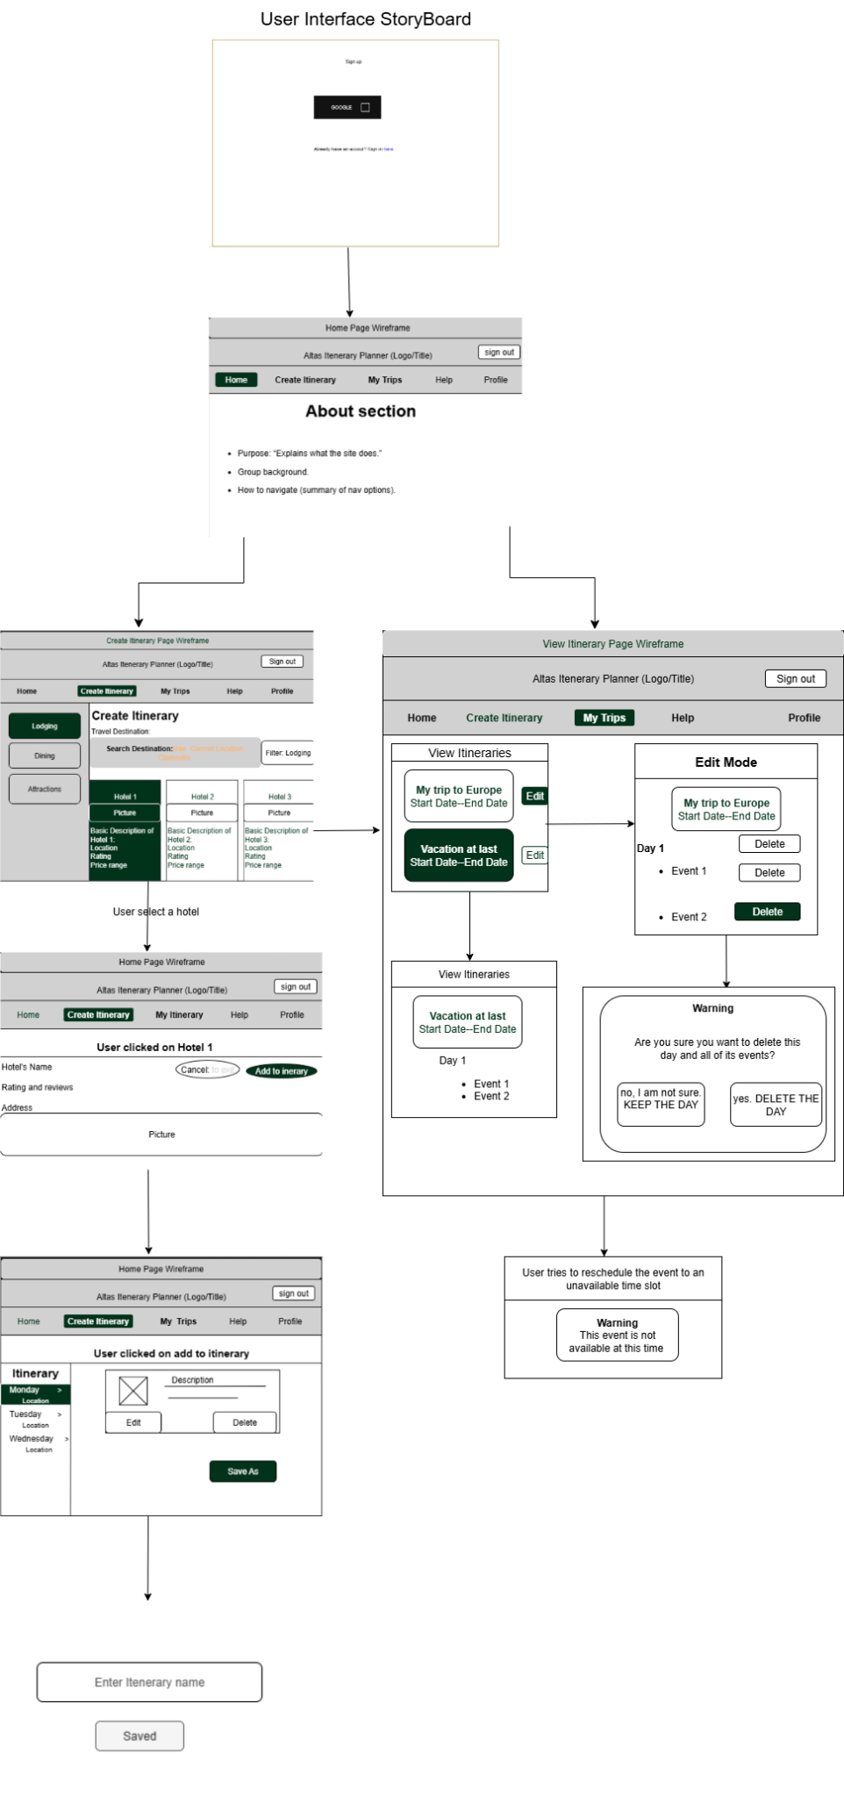

Slide 4
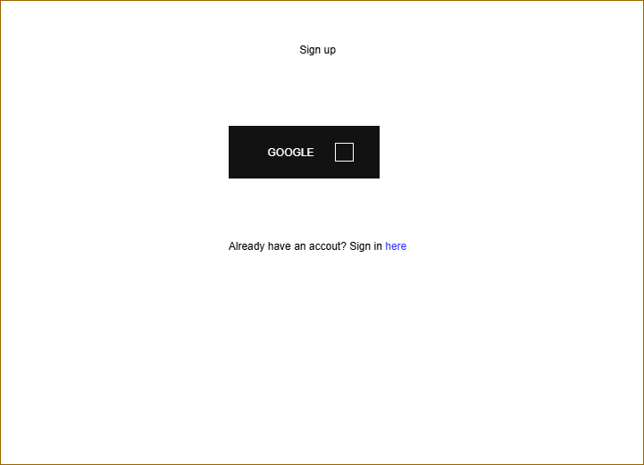
Sign-up and sign in page

Slide 5
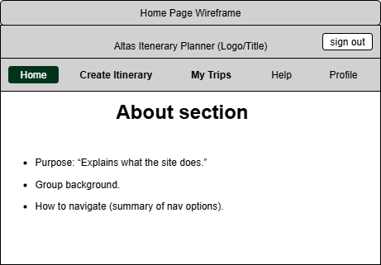
The Home Page
About Section
Instructions
Personnel
Nav Bar

Slide 6
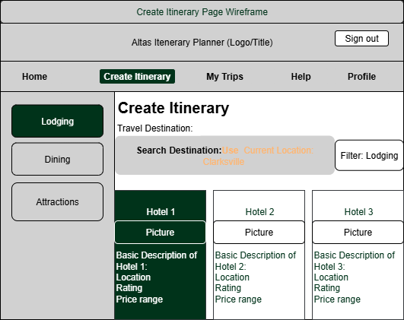
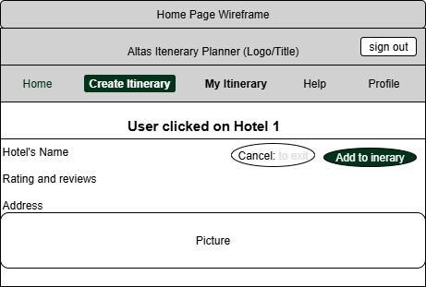
Create Itinerary
Travel destination
Geolocating
Location categories
Subcategories in the filter
Successful Completion

Slide 7
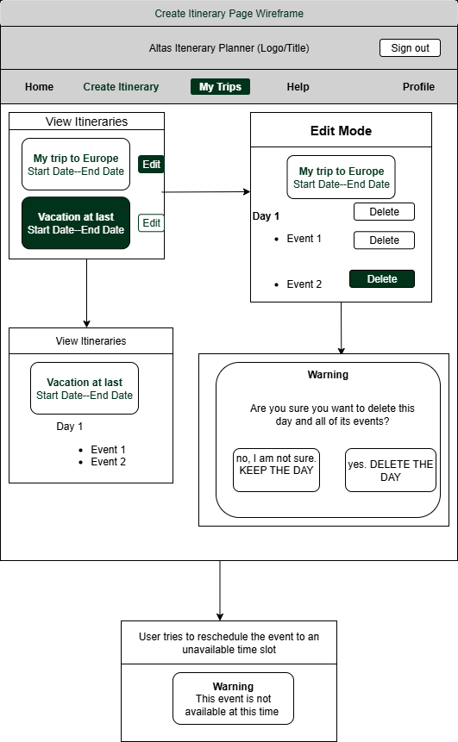
View Itinerary
Empty Page
Card Presentation (and Contents)
Expanded cards
Edit mode (both event and day)
Warning

Slide 8
THE BACK END

Slide 9
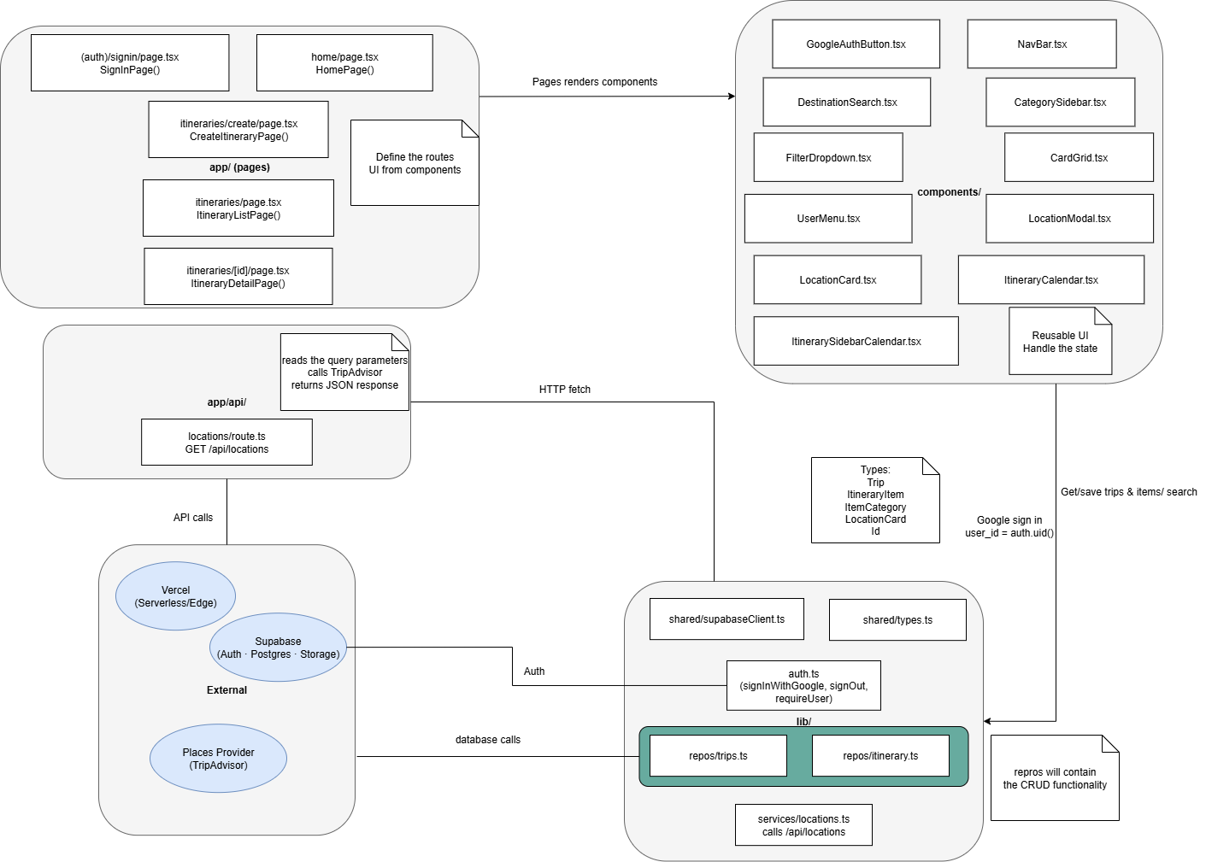
React
How it works
How it fits with the project
Examples of how it will be used
All of the many components
Sharing is caring (and more efficient)

Slide 10
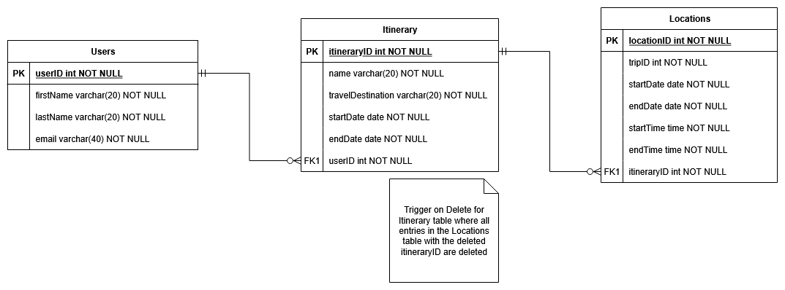
SupaBase
Why Supa?
How it will help
The entities of the database

